Slide 1
COLLEGE CANTEEN MANAGEMENT
By-
Manjunath Kallatti 1BM19IS086 N Prabhu 1BM19IS086

Slide 2
ABSTRACT
This system prominently relieves the burden on the canteen's end, as the entire method of taking orders is computerized. Once an order is placed on the android phone, it is entered into the database and then retrieved, in pretty much real-time, by an android application on the canteen's end. Within this application, all items in the order are displayed, along with their equivalent options and supply details, in a summarizing and easy-to-read manner. This allows canteen staff to speedily go through the orders placed and produce the needed items with minimal delay and confusion.

Slide 3
PROBLEM STATEMENT Implementation of an android application for managing the college canteen system For minimizing the time delay for food orders.
WIDGETS
Button Email
EditText Phone
TextView View
ImageView Array Adapter
RecylerView BitMaps
ScrollView Intent
Password

Slide 4
THE OBJECTIVES OF THIS PROJECT IS:
I. To order food rapidly
II. To make it convenient for people who have limited time
III. Cost reduction
IV. Reduced paperwork
V. Computerized Order and billing system

Slide 5
SERVICES :
Registration: register by using Respective college email id.
Admin Login: Admin need to log in using valid login credentials to access the system
View Orders: Can view all the orders received from the registered students.
Update Inventory: Add/ Remove Food Items :
User Login: Login by using Respective college email id.
Menu Items: Students can order any food item from the menu.
Place an Order a review of the order will be displayed and then students can proceed to pay
Qrcode Generation and Scanner :After payment Qrcode will be generated and admin can scan the Qrcode.

Slide 6
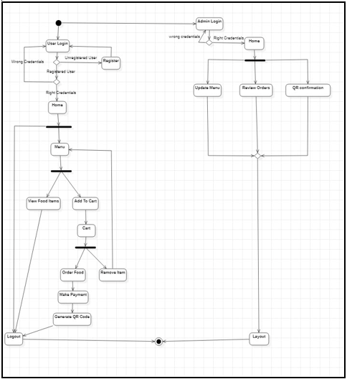
FLOW CHART

Slide 7
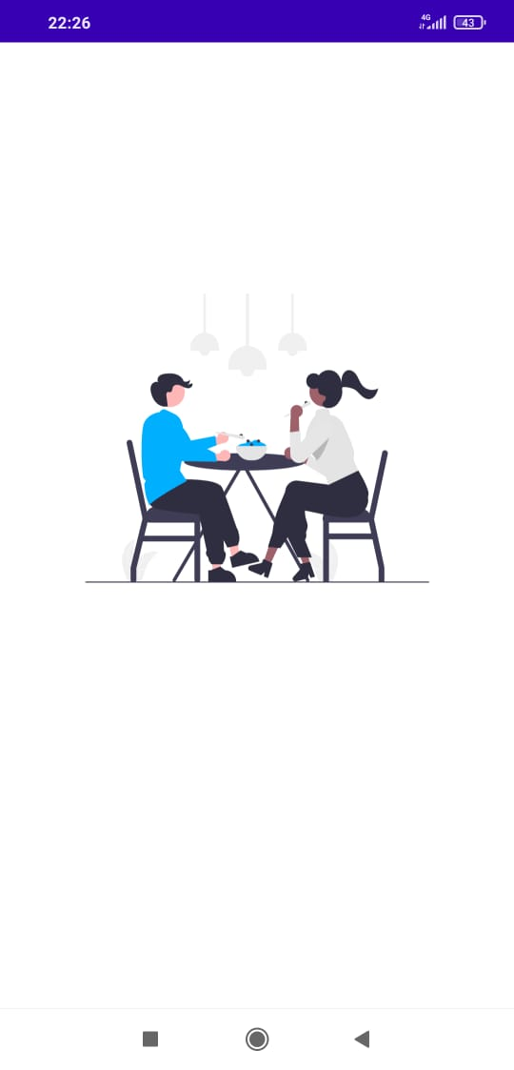
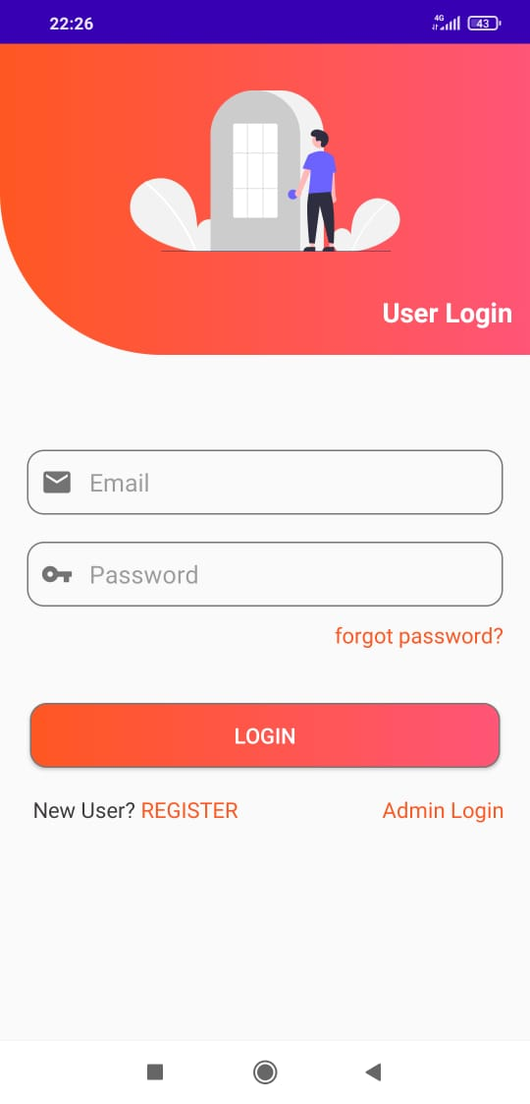
USER INTERFACE

Slide 8
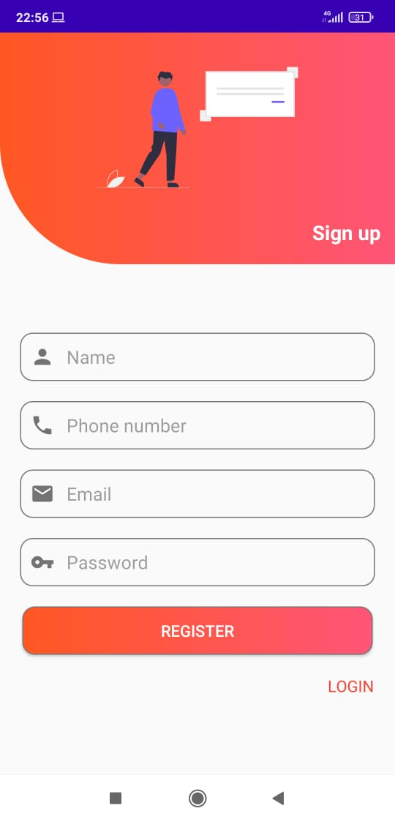
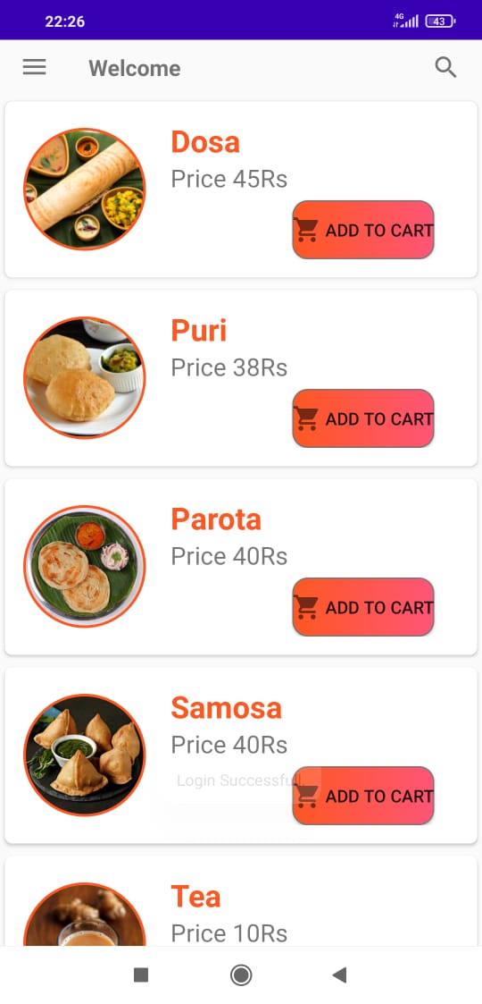

Slide 9
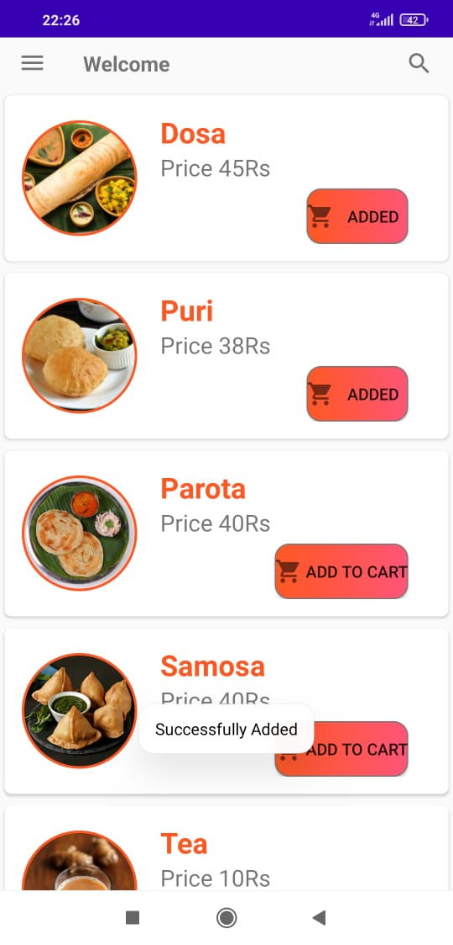
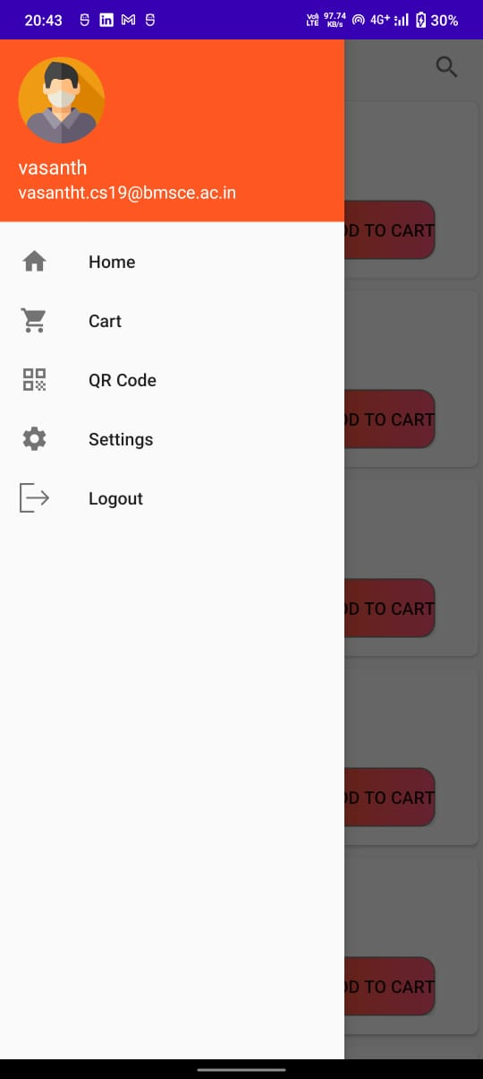

Slide 10
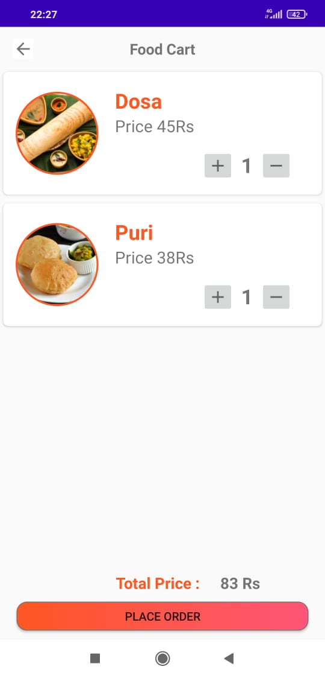
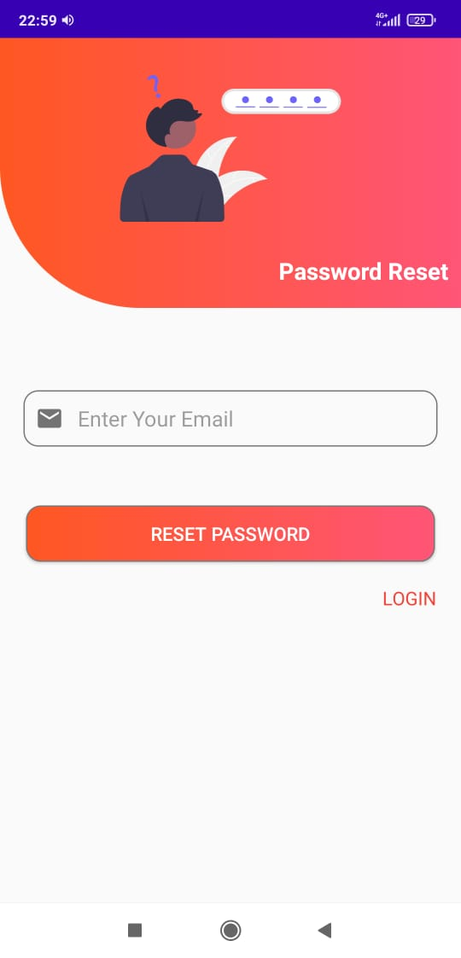

Slide 11
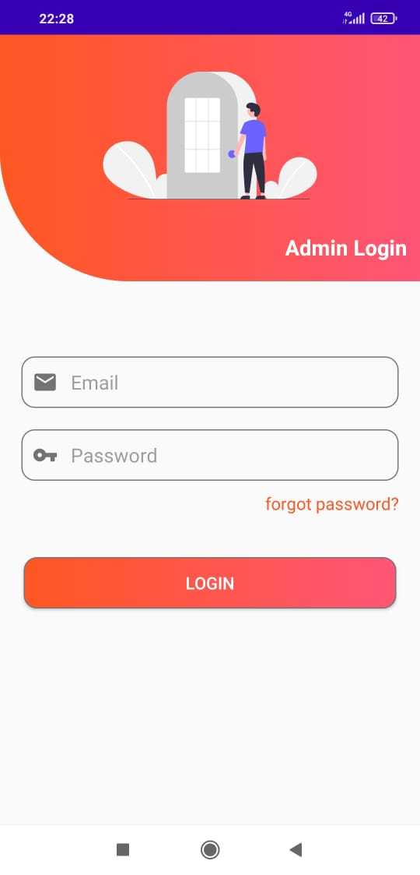
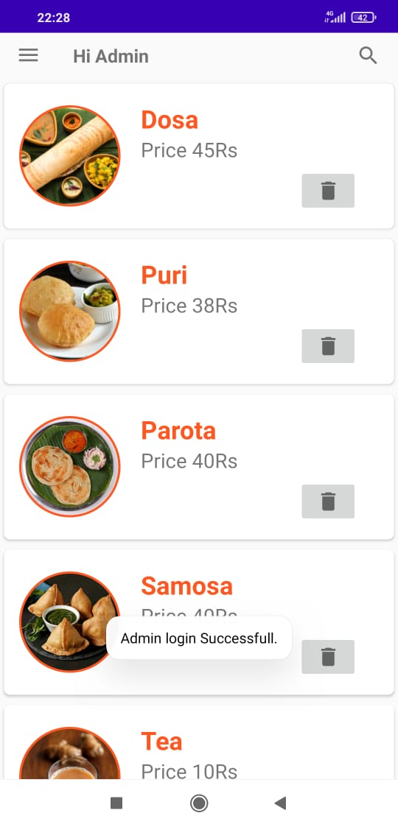
ADMIN INTERFACE

Slide 12
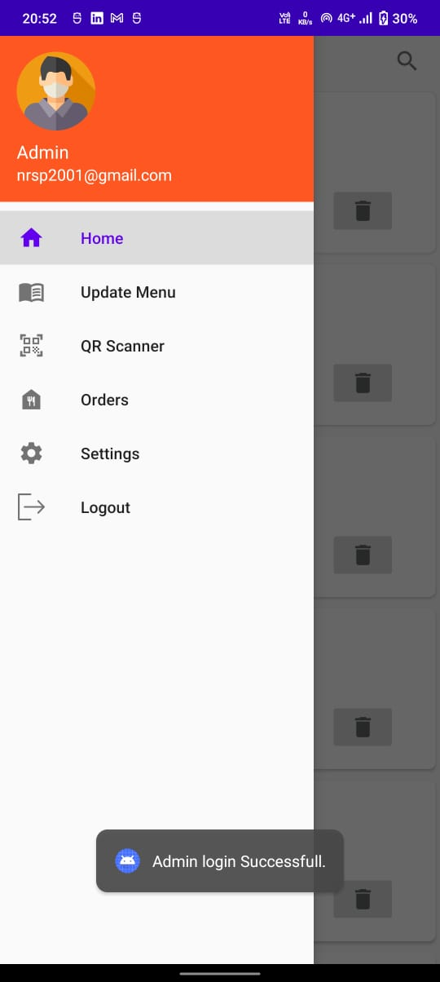
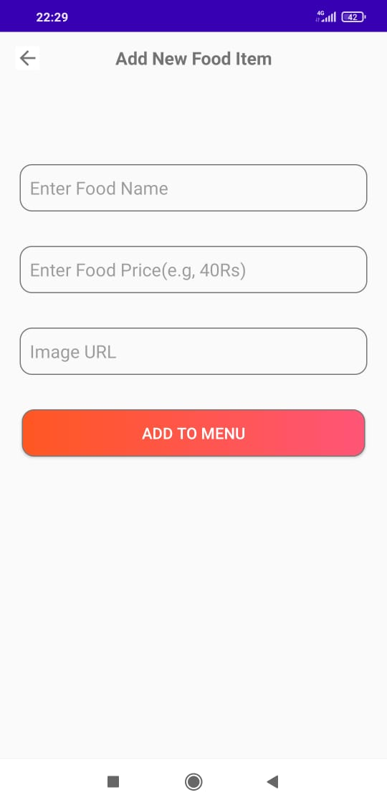

Slide 13
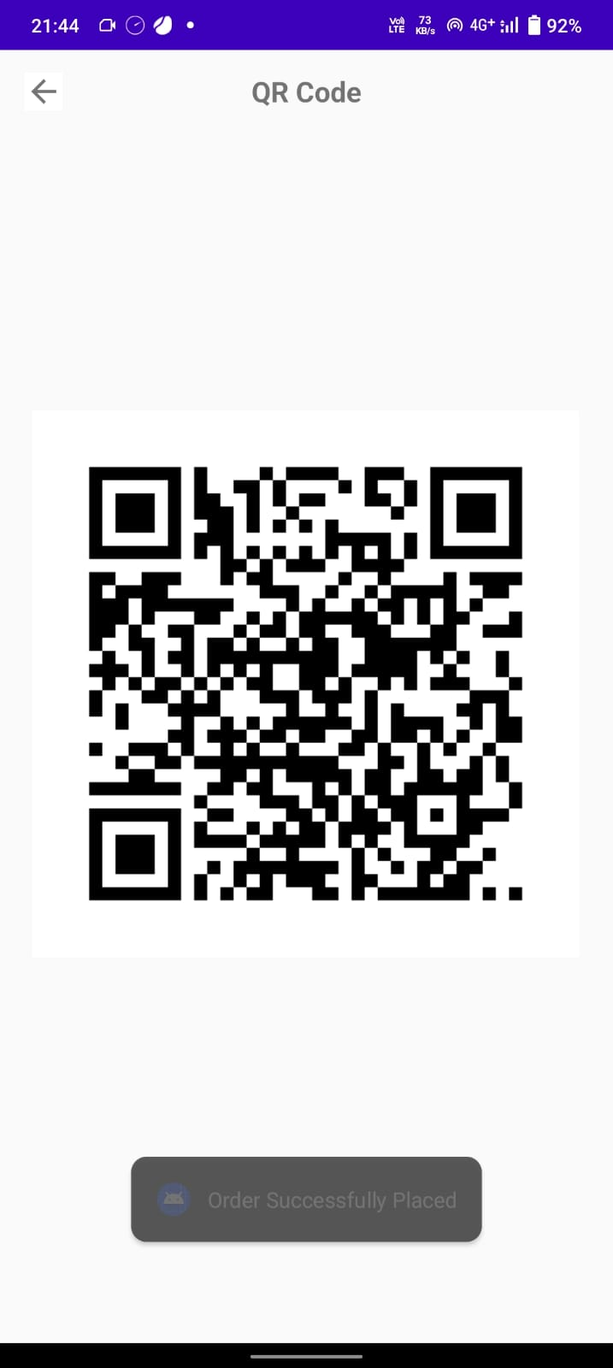
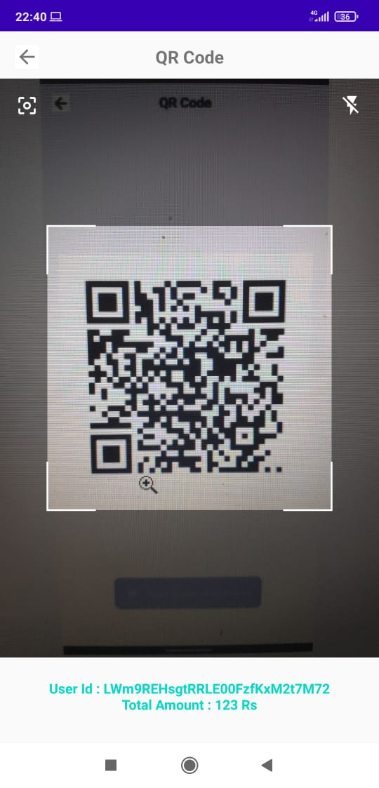

Slide 14
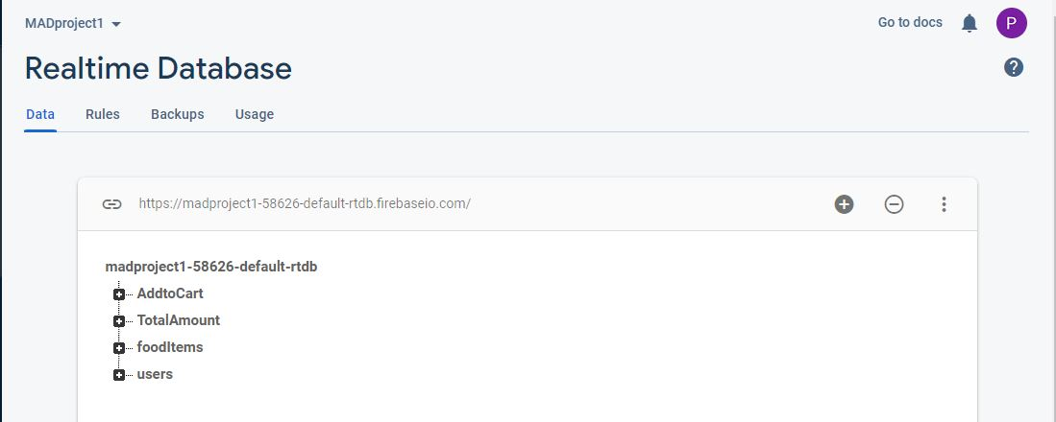
DATA BASE

Slide 15
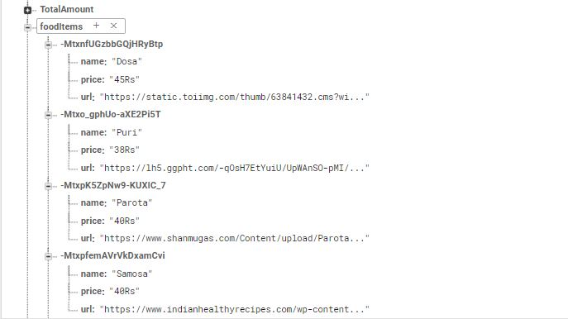

Slide 16
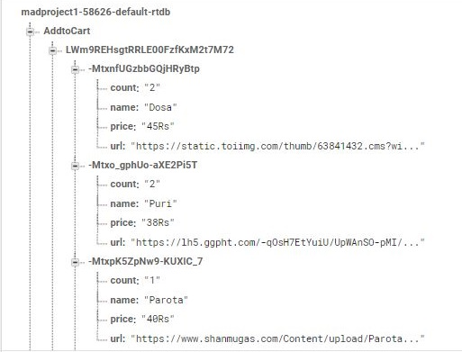
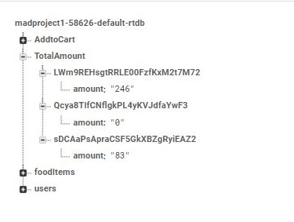

Slide 17
PLATFORM USING:
Android Studio: Android Studio provides the faster tools for building app on every type of Android device
Firebase: database for storing the data.
Android phone: To run the app
REFERENCES
https://developer.android.com/
https://developers.google.com/maps/documentation/geocoding/start
https://firebase.google.com

Slide 18
THANK YOU ☺

